Slide 1
High potential Leaders Program

Slide 2

Agenda
Strategic Development Process
An Innovative Approach
Curriculum Architecture and Development
Collaborators

Slide 3

Strategic Development Process

Slide 4
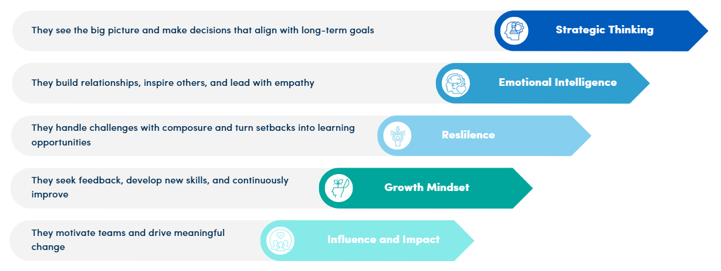
What is a High Potential Leader?
The high potential leader is an individual who consistently shows strong performance and demonstrate traits in their current role that will translate well into a leadership position in the future. These key traits include:

Slide 5

Why now?
This has been a priority for several years, but now we are positioned with new instructional designers on staff and a broad array of subject matter experts to assist in content development and delivery to provide a robust curriculum for our high potential leaders.

Slide 6

Departmental Impact
Participants will be engaged with subject matter experts from several departments that support key business, strategic and operational functions across the university.
Business Services – Financial Management, Procurement, Student Accounts, Business Systems and Reporting, Internal Policy and Controls and Campus Mail
Resource Planning
Human Resources
University Facilities
UB Foundation
Research and Economic Development
Institutional Analysis
University Advancement

Slide 7

Eligible Candidate Pool
The focus will be on professional employees in current business roles across UB, however eligible candidates include constituents from all units across UB who have demonstrated a high level of ability, ambition and drive in their current role and aspire to take on a senior leadership position in the future and would benefit from this curriculum.

Slide 8
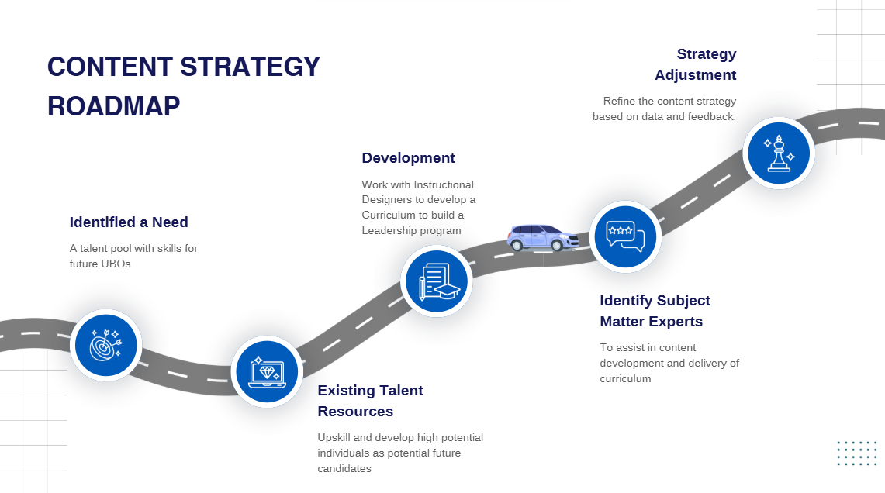
Divider Slide Title
Sub-topic

Slide 9
An Innovative Approach

Slide 10

Fresh Take
The new hybrid structure of the program is to fully enhance the knowledge and skills for those participating while also providing a credential to assists in promotional opportunities and career advancement into leadership roles. All while progressing with a cohort of peers to foster professional relationships with peers and mentors.

Slide 11
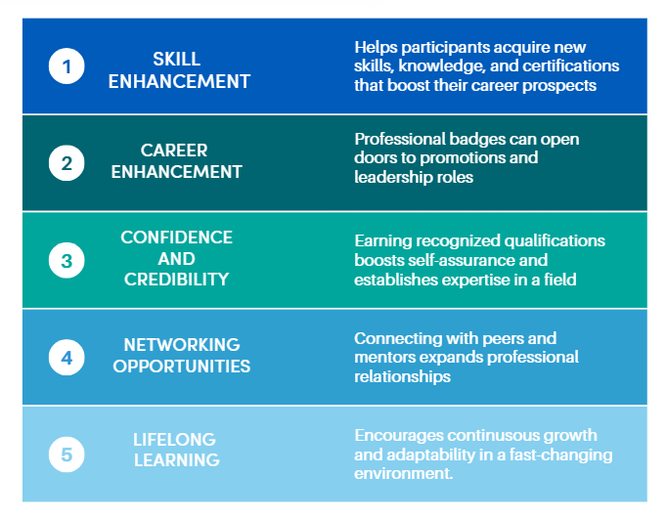
Benefits of the Program
For Individuals:

Slide 12
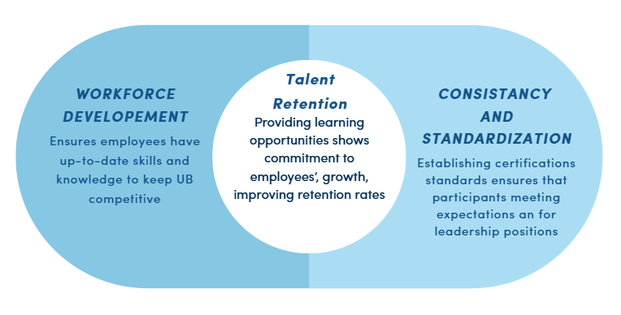
Benefits for UB

Slide 13

Identifying Candidates
Those with interest
Recommendations
Supervisor Approval
Experience/Longevity

Slide 14
Curriculum Architecture and Development

Slide 15
Curriculum
Development for
Emerging Leaders
Org
SME
Training Design
Delivery
Course Content
Training Domain
Collaborate with organizational stakeholders to establish goals and align on desired learning outcomes
Engage Subject Matter Experts (SMEs) to facilitate the identification of relevant content and ensure the effective development and delivery of training materials
Instructional Design working in collaboration with Stakeholders and SMEs to develop and produce training products deliverables
The content of the training products such as text, graphics, audio, videos, quizzes, and live training activities
The format or place in which training will be hosted. Classroom/Virtual/Webhost (UBEdge)
The training model through which training will be delivered to learners, utilizing a hybrid approach that combines ILT, VILT, and eLearning

Slide 16
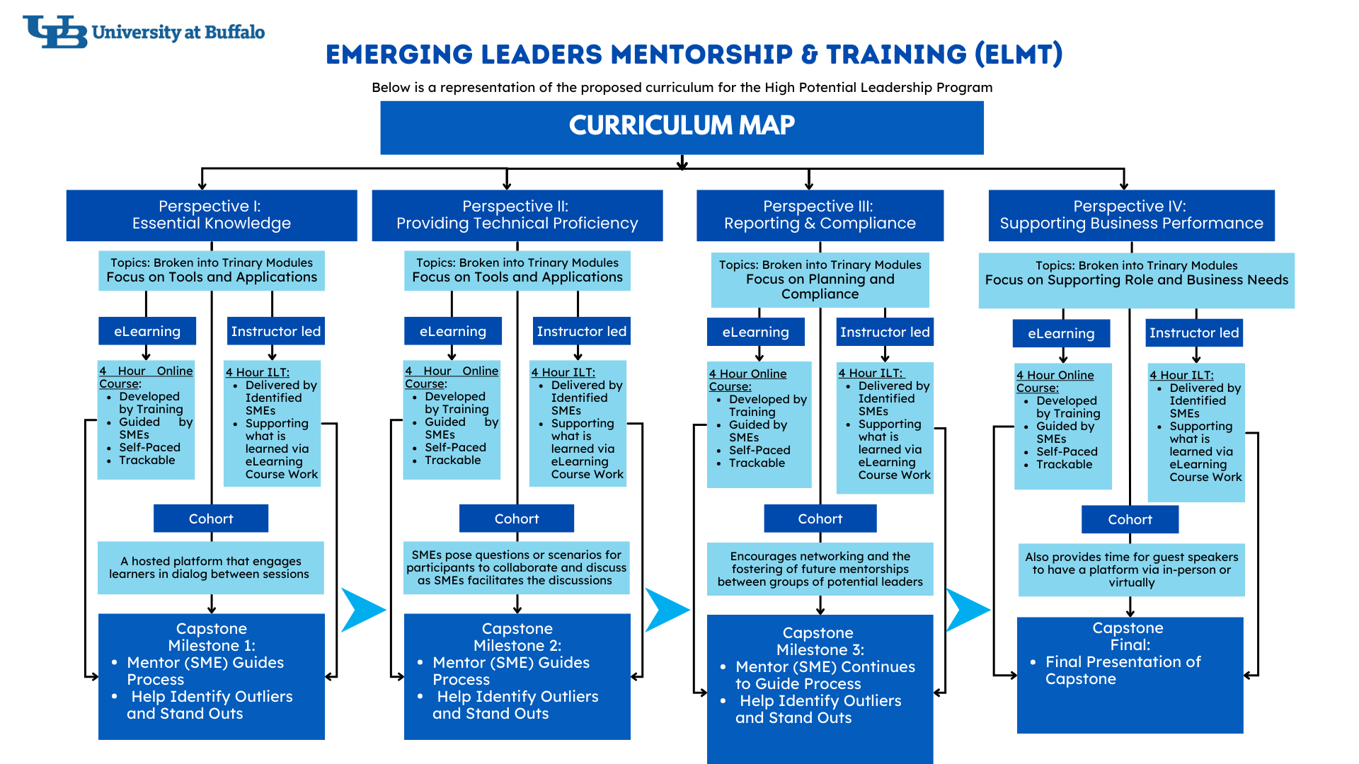

Slide 17

Courses
eLearning
Same topic as the Instructor Led course
Contains foundational material to build understanding for the Instructor led portion
Self-Paced, can contain, videos, activities, interactives, reading
Engaging and builds excitement for next phase
Instructor Led
A continuation of the eLearning
Expand upon the ideas of the eLearning
Discussion or Activity-Based
If Lecture based, includes class questioning techniques.

Slide 18

Discussion Based ILT
Instructor-Led Training (ILT) Outline:
1. Introduction (5-10 mins) Objective: Set the tone for the session and create an open, friendly environment.
Welcome the group and briefly introduce yourself.
Recap the main concepts from the eLearning module (a quick review to refresh everyone's memory).
Mention that this session will expand on those ideas and provide more opportunities to explore the material.
2. Recap and Reflection (10-15 mins) Objective: Encourage reflection on the eLearning content and introduce class discussions or activities.
Discussion Prompt: "In the eLearning, we learned about X. Can anyone share an example of how they’ve seen this in action?"
3. Activity-Based Option (15-20 mins) Objective: Promote earning through discussion-based engagement with content
Divide the class into small groups. Give each group a scenario related to the eLearning content and have them discuss and apply what they learned.
Provide more in-depth content based on the topics of the days learning.
After introducing newer content move into activity

Slide 19

Lecture Based ILT
Instructor-Led Training (ILT) Outline:
1. Introduction (5-10 mins) Objective: Set the tone for the session and create an open, friendly environment.
Welcome the group and briefly introduce yourself.
Recap the main concepts from the eLearning module (a quick review to refresh everyone's memory).
Mention that this session will expand on those ideas and provide more opportunities to explore the material.
2. Recap and Reflection (10-15 mins) Objective: Encourage reflection on the eLearning content and introduce class agenda.
3. Expanding on Key Concepts (15-20 mins) Objective: Dive deeper into the concepts introduced in the eLearning.
Provide a brief lecture that expands on key concepts, offering more detailed explanations and real-life applications.
4.Class Questions (Interactive Lecture):
Objective: Encourage participant input, fostering a conversational atmosphere rather than a one-way lecture.
"Why do you think this idea is important in your daily work?"
"How could you apply this in a challenging situation?"
"What would happen if we didn’t use this method?"

Slide 20

Micro Sessions
Instructor Led
Discussion or Activity-Based
Shorter sessions
Doubled up with in a month

Slide 21



Cohort
Online Discussions
Time between class is not lost. Engagement is continuous in the form of:
Forums for continuous discussions
Guest Speakers
Opportunities for additional training such as HR soft skill offerings
Guest Speakers
Additional Training Opportunities

Slide 22
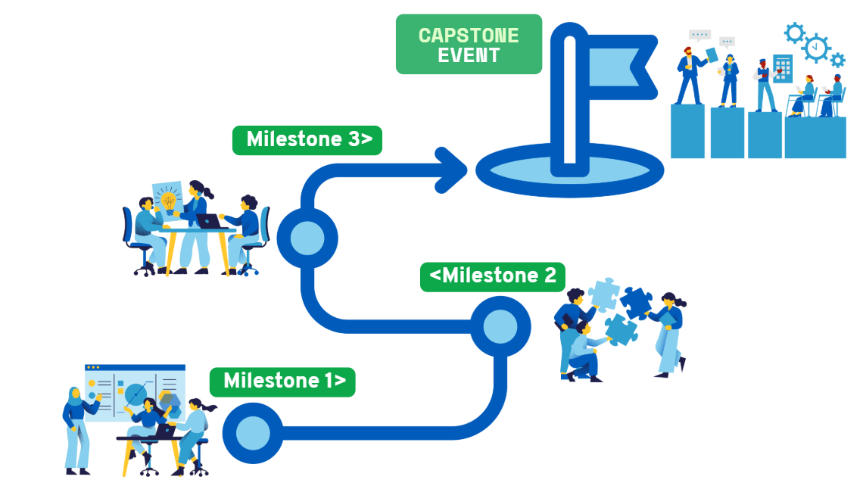
Capstone

Slide 23
Perspective I: Essential Knowledge
Foundations and Finance: ELMT and UB Financial Overview
Building Blocks: The Essentials of University Budget Planning
Core Connections: Essentials for Business Services
People Power: HR Staff Planning, Workforce Planning & Organization Structure
Space to Thrive: Facilities Planning
Funding Fuel: Navigating the Essentials of UBF and Research Foundations
Core Focus: Establishing a foundation of knowledge that is critical to the business functions and responsibilities of a Unit Business Officer.

Slide 24
Perspective II: Providing Technical Proficiency
Tech Essentials: Intro to Technical Proficiency & UPlan for UBOs
Skill Builder: Intermediate SIRI Refresher
Skill Builder: Intermediate Tableau and OIA Refresher
Blue Basics: ShopBlue
Blue Basics: Blue Services and Concur
Core Focus: Ensuring proficiency in the technical tools and software integral to business operations.

Slide 25
Perspective III: Reporting & Compliance
Accountability in Focus: Introduction to Reporting & Compliance/Reporting and Analysis SIRI
Fiscal Focus: Reporting & Analysis in Budgeting
The Reporting Edge: Reporting: Reporting for Business Services
HelioCampus: Labor Spending Analysis Through a Standard Activity Model
The Reporting Edge: Reporting for OIA
Core Focus: Cultivating analytical thinking, fostering critical data analysis skills, and enhancing a strong awareness of compliance and oversight responsibilities.

Slide 26
Perspective IV: Supporting Business Performance
Behind the Scenes: Introduction to Business Performance/Fundamentals of Sponsored Projects Administration
Advanced Planning and Funds
The Art of Acquisition: Procurement
Accounts in Action: Managing Payables, Receivables & Collections
Safeguarding Trust: Essentials of Risk & Security Management. Internal Controls and Fraud Awareness
Financial Compass: Navigating Budget Metrics
Core Focus: Integrating skills and responsibilities strategically to effectively support and advance business objectives.

Slide 27
Collaborator Role

Slide 28

Contributions
Instructor
Presenter, In-Person or Virtually
Content Knowledge Specialist
A person with specific or expert knowledge of the topic who can assist in content development
Advising Mentor
One chosen to act in the role of mentor through out the length of the program to a group of participants. Guiding the learning process towards a Capstone Event.
Learning Impact Partner
Anyone who can enrich the learning experience. Guest speakers, panel and classroom participants, HR Training Partners, etc.

Slide 29





Next Steps
Invite
1
An invitation for a One-on-One session, along with preparatory information, will be sent to you in advance
Step One
Meeting One-on-One
2
During our initial meeting, we will outline an tailored training plan, beginning with the eLearning component
Step Two
Feedback Phase
3
I will submit the eLearning to you at various stages for feedback, making adjustments as necessary and scheduling meetings as needed for further discussion
Step Three
Steps 1-3 are Repeated for the instructor-Led Portion
Repeat
The same process will be applied to the instructor-led portion of the training, ensuring consistency and thoroughness throughout both phases

Slide 30







Anticipated Timeline
Fall
Winter-January
Rolling Development
Open Application Process
Tentative Launch of Program-Delivery of first Course
With training delivered monthly, we will sustain a rolling development cycle designed to remain three months ahead of the delivery schedule
02
04
06
01
03
05
Cohort Selection
Next Set of Invitations
Impact
Possible second Wave of Cohort Selections
Meaningful connections are made, driving the continued growth and development of the program
Individuals selected for first Cohort are notified

Slide 31

Questions

